Slide 1

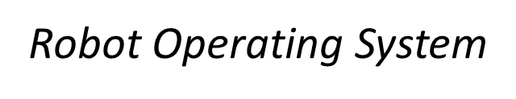










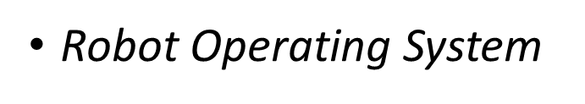
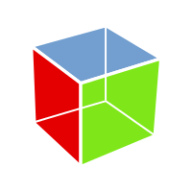















Slide 2
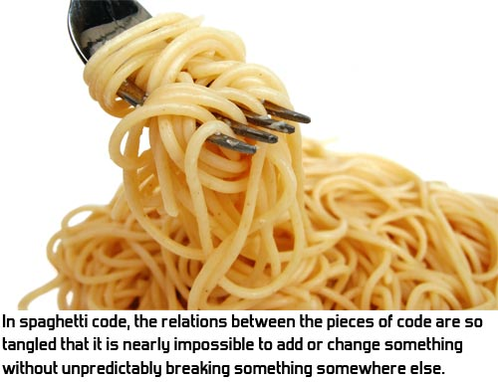
What is ROS?
The Robot Operating System (ROS) is a set of software libraries and tools that help you build robot applications. From drivers to state-of-the-art algorithms, and with powerful developer tools, ROS has what you need for your next robotics project. And it's all open source.
Feels like spaghetti

Slide 3
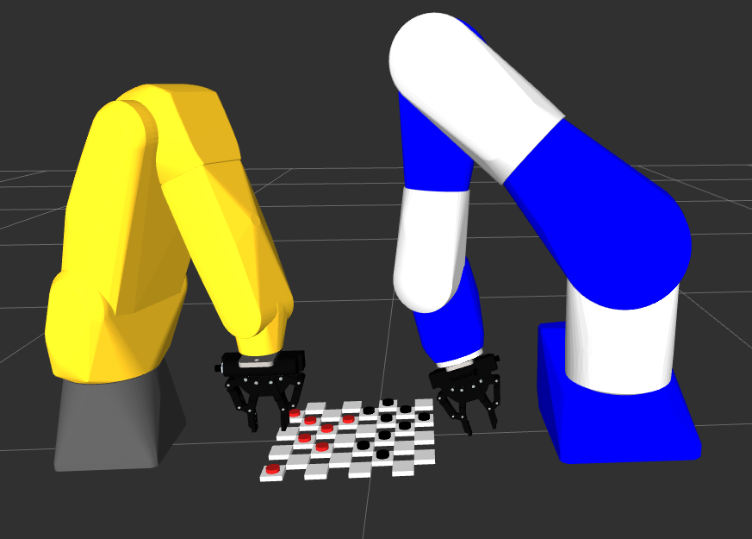
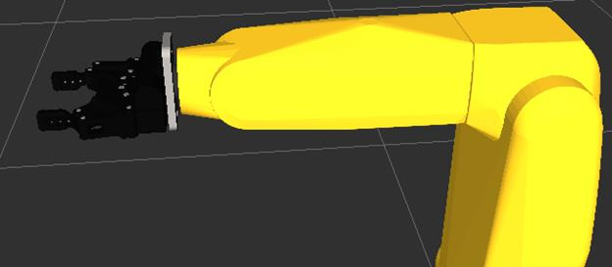
Make ROS better
Added ROS Version Dependency via Github
Added ROS Message Definitions via Github
Model Fanuc Robot in ROS URDF/Rviz
Added Gripper to Fanuc Robot in URDF/Rviz
Model Kitting Demo bolt and bolt holder STL in ROS Rviz
Model Fanuc Robot with Gripper with Motoman with Gripper in ROS URDF/Rviz collaborating using extended CRCL

Slide 4
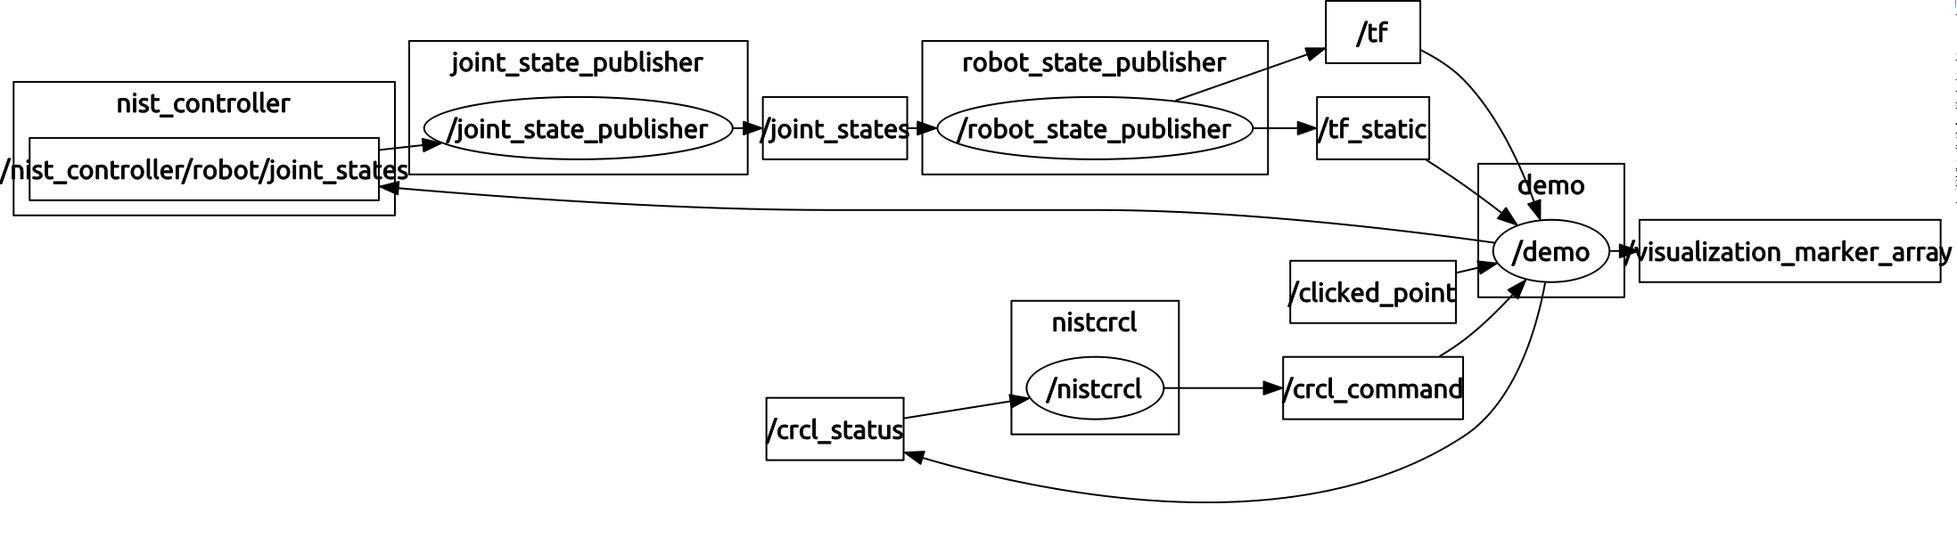
Simpler Real-time Control Architecture
Displayed with ROS rqt_graph
Robot with gripper
Bolt Rviz Simulation
ROS CRCL Package
Simpler (for now) - no ROS moveit, joint_state_publisher does arm and gripper joint updates

Slide 5
Added ROS Version Dependency via Github
Package Version Dependencies
Bash Script
!/bin/bash
# Sorted Package Version Information in simple HTML Table Format
# Usage ./versioninfo.bash pkgname
# Assume ROS installed and pkg compiles
pkgs=`rospack depends $1 |sort `
echo "<HTML><BODY>"
echo "<h1> " $1 " Package Version Dependencies </h1>"
echo "<TABLE>"
echo "<TR><TH>Package</TH><TH>Version</TH></TR>"
for pkg in $pkgs
do
ver=`rosversion $pkg `
echo "<TR><TD> $pkg </TD><TD> $ver </TD></TR>"
done
echo "</TABLE></BODY></HTML>"
Package | Version
actionlibmsgs | 1.11.8
catkin | 0.6.16
classloader | 0.3.1
cppcommon | 0.5.6
eigenconversions | 1.11.7
eigenstlcontainers | 0.1.4
fcl | 0.3.2
gencpp | 0.5.3
genlisp | 0.4.15
genmsg | 0.5.6
genpy | 0.5.7
geometricshapes | 0.4.3
geometrymsgs | 1.11.8
kdlparser | 1.11.8
libccd | 1.5.0
messagegeneration | 0.2.10
messageruntime | 0.4.12

Slide 6
Added ROS Message Definitions via Github
nistcrcl/CrclCommandMsg
Python Program
Type | Name | Comment
uint8 | initCanon=1
uint8 | endCanon=2
uint8 | actuatejoints=3
uint8 | moveto=4
uint8 | dwell=5
uint8 | message=6
uint8 | moveThroughTo=7
uint8 | setCoordinatedMotion=8
uint8 | stopMotion=9
nistcrcl/CrclStatusMsg
Type | Name | Comment
uint8 | done=0
uint8 | error=1
uint8 | working=2
stdmsgs/Header | header
uint32 | seq

Slide 7
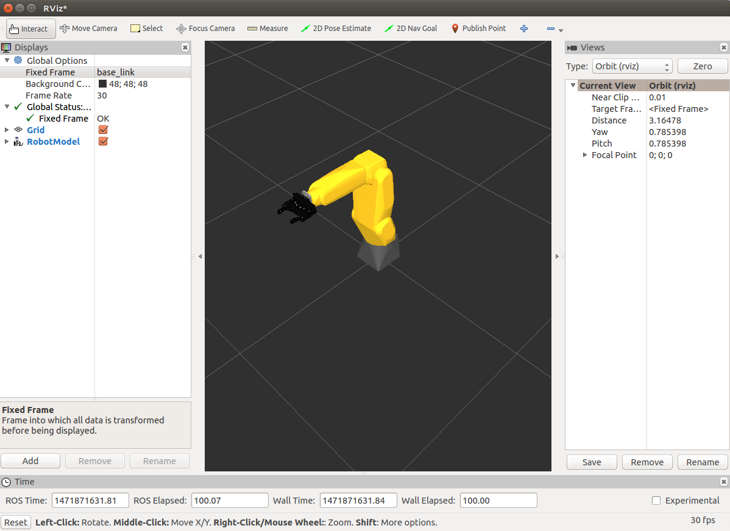
Fanuc LRMate 20iD Robot in ROS/URDF/Rviz

Slide 8
Added Gripper to Fanuc Robot in URDF – and Rviz for pick/place

Slide 9
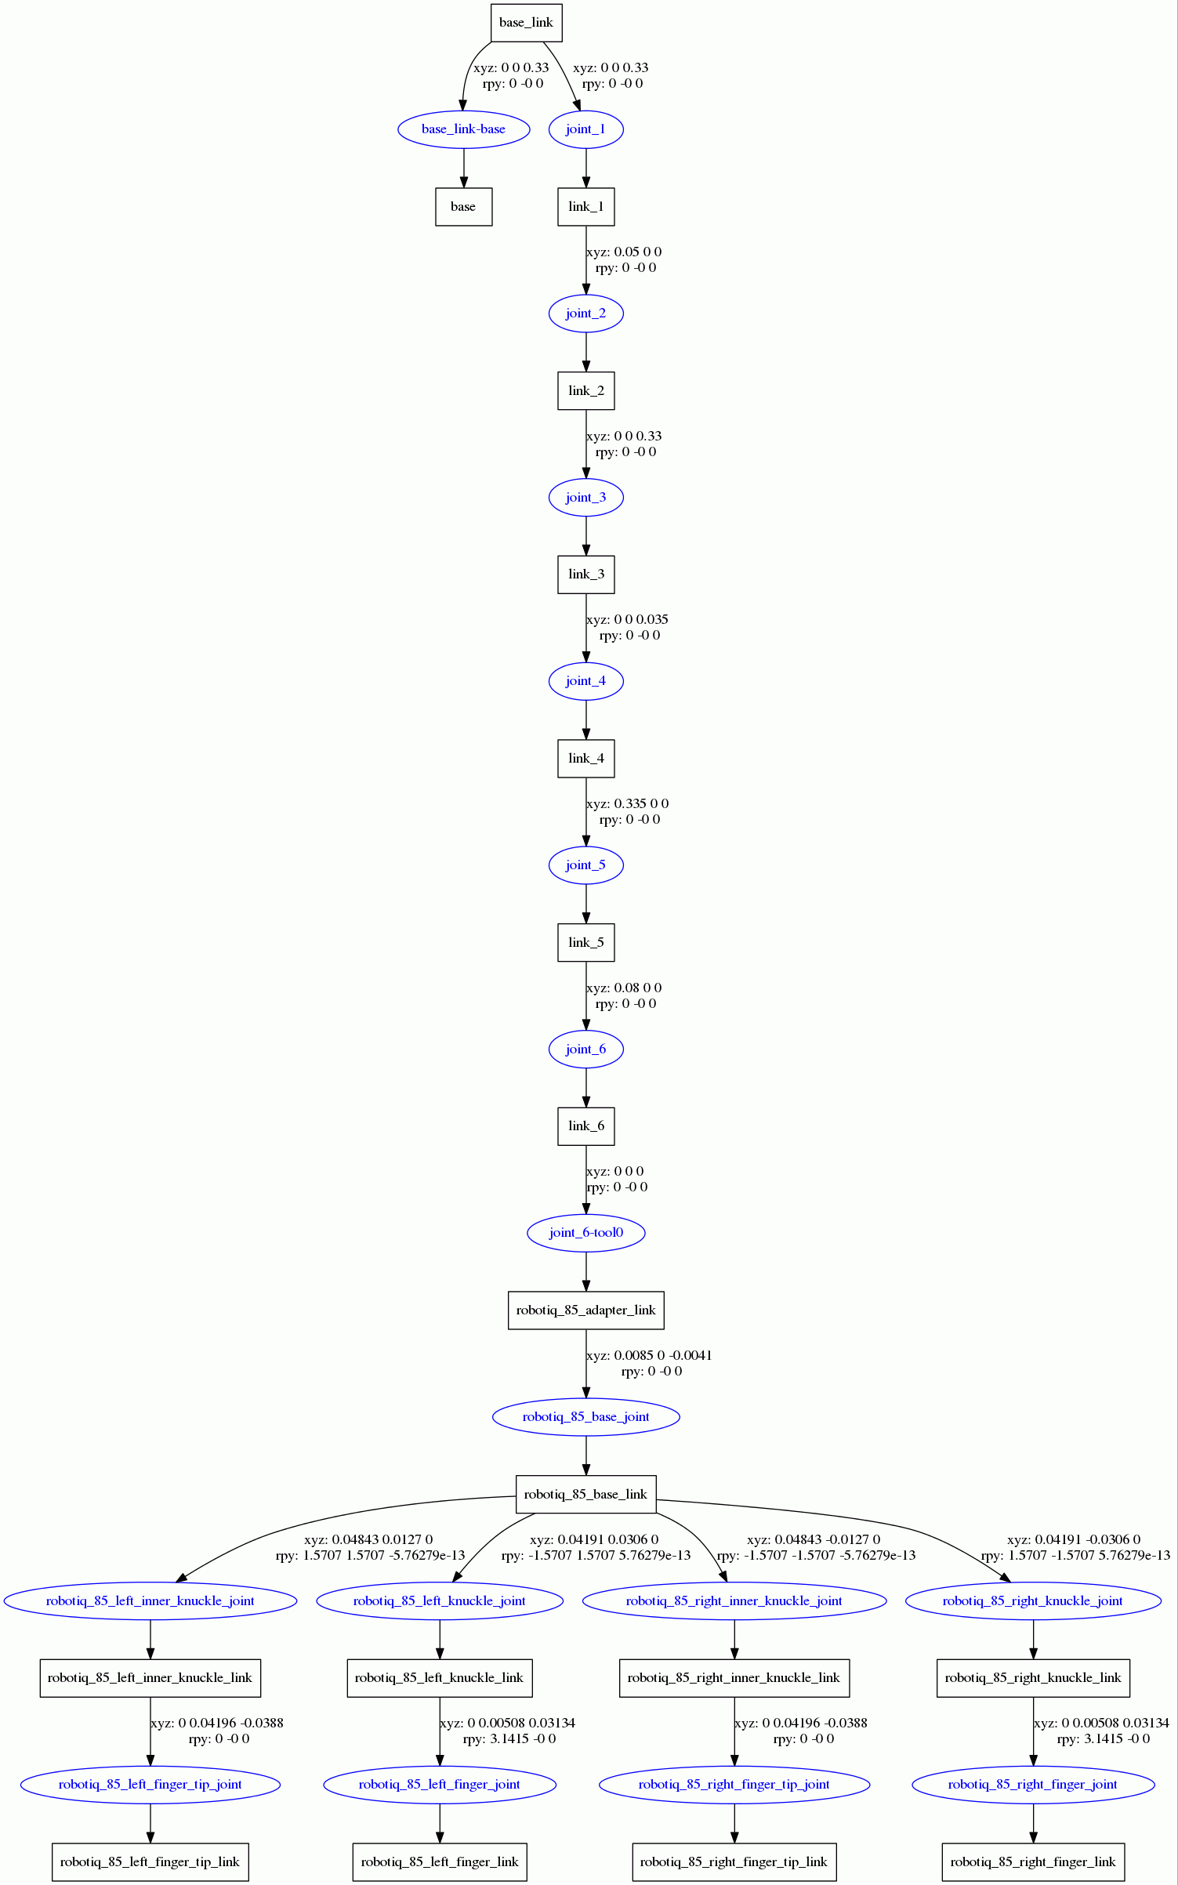
Fanuc and Robotiq URDF

Slide 10
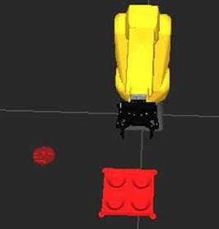
Added Bolt and Boltholder as STL to ROS using Rviz “Markers”

Slide 11
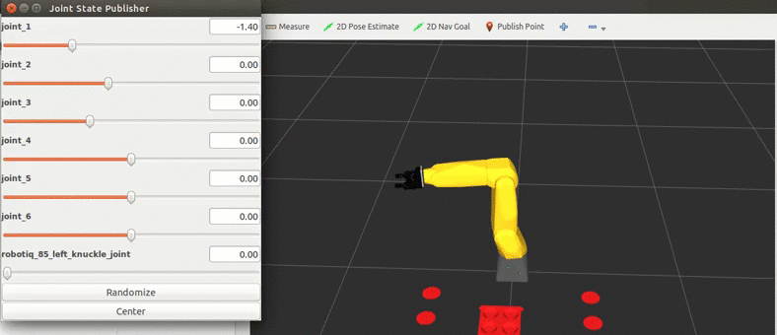
Rviz Bang-bang Simulation of Bolt placement

Slide 12
ROS URDF Macro language - Xacro
Once the basic URDF is in place, robot and gripper definitions can become a macro in Xacro (ok programming with XML not easy peasy)
Now Connect the robots in ROS Xacro/URDF
<?xml version="1.0"?>
<robot name="fanuc_lrmate200id" xmlns:xacro="http://ros.org/wiki/xacro">
<xacro:include filename="$(find fanuc_lrmate200id_support)/urdf/lrmate200id_macro.xacro"/>
<xacro:include filename="$(find fanuc_lrmate200id_support)/urdf/robotiq_c2_model_macro.xacro"/>
<xacro:include filename="$(find motoman_sia20d_support)/urdf/sia20d_macro.xacro"/>
<xacro:fanuc_lrmate200id prefix="fanuc_"/>
<xacro:robotiq_c2_model prefix="fanuc_"/>
<xacro:motoman_sia20d prefix="motoman_"/>
<xacro:robotiq_c2_model prefix="motoman_"/>
<link name="world" />
<!-- Dummy Link -->
<link name="link0" />
<joint name="world_joint" type="fixed">
<parent link="world" />
<child link="link0" />
<axis xyz="0 0 1"/>
</joint>
<!-- First Robot -->
<joint name="fanuc_joint_0" type="fixed">
<parent link="link0" />
<child link="fanuc_base_link" />
<origin xyz="0 -0.5 0" rpy="0 0 0"/>
</joint>
<!-- Second Robot -->
<joint name="motoman_joint_0" type="fixed">
<parent link="link0" />
<child link="motoman_base_link" />
<origin xyz="0 0.5 0" rpy="0 0 0"/>
</joint>

Slide 13
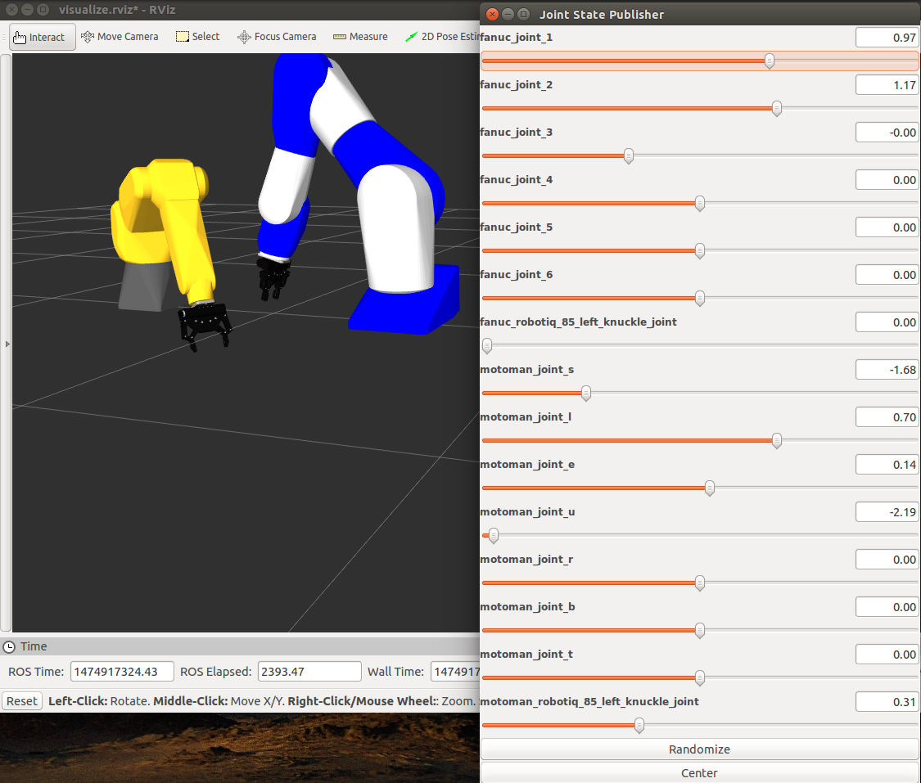
Model Fanuc and Motoman Robots in ROS

Slide 14
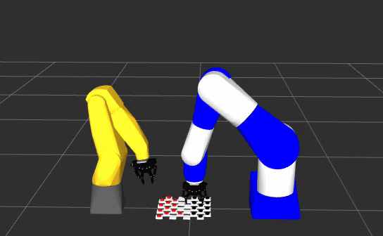
Fanuc and Motoman Robots Playing Checkers

Slide 15
What is useful
Kinematics is confusing, simple modifications to tool offset can assist in orienting tool correctly
No heavy lifting - moving robots around is not hard – change of base offset pose
No safety reports
Validate motion concepts
Works for multiple robots ask Paul Stahura

Slide 16
Future
Gomotion Jerk-based trajectory motion ROS library
Integration of vision and Mongo DB for object recognition and archiving
Collision checking
Prismatic gripper
Dynamic change of end effector issue – only Baxter handles, ROS ignores
Gazebo with physics modeling

Slide 17
Block diagram

